Slide 1
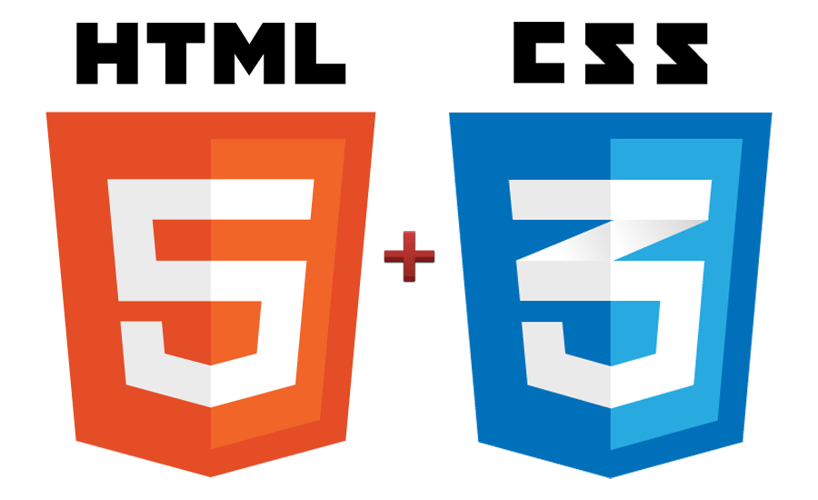

CSS Tutorials
WEB DEVELOPMENT

Slide 2
CSS Fundamental
1
2
CSS3 Overview
目录
CONTENTS
3
Responsive Design

Slide 3
CSS Fundamental
1
2
CSS3 Overview
目录
CONTENTS
3
Responsive Design

Slide 4
Definition of CSS
CSS stands for Cascading Style Sheets
Styles - define how to display HTML elements
Styles are normally stored in Style Sheets
Definition:
Cascading Style Sheets (CSS) – is a style sheet language used for describing the look and formatting of a document written in a markup language. You write CSS rules in elements, and modify properties of those elements such as color, background color, width, border, font etc.
lay
out

Slide 5
CSS
Cascading Style Sheets, or CSS, is a style sheet language used on the Web
CSS specifications are maintained by the World Wide Web Consortium (W3C)
Three versions of CSS exist: CSS1, CSS2, and CSS3

Slide 6
CSS1
The first CSS specification to become an official W3C Recommendation is CSS level 1, published in December 1996. Among its capabilities are support for-
Font properties such as typeface and emphasis
Color of text, backgrounds, and other elements
Text attributes such as spacing between words, letters, and lines of text
Alignment of text, images, tables and other elements
Margin, border, padding, and positioning for most elements
The W3C no longer maintains the CSS 1 Recommendation.

Slide 7
CSS2
CSS level 2 specification was developed by the W3C and published as a recommendation in May 1998. A superset of CSS 1, CSS 2 includes a number of new capabilities like-
Positioning
Visual Formatting
Media Types
Interfaces
z-index
and new font properties such as shadows.

Slide 8
CSS3
Work on CSS level 3 started around the time of publication of the original CSS 2 recommendation. The earliest CSS 3 drafts were published in June 1999
User Interfaces
Accessibility
Columnar layout
Mobile Devices
Scalable Vector Graphics

Slide 9
Advantages
Separation of content from presentation
CSS facilitates publication of content in multiple presentation formats based on nominal parameters. Nominal parameters include explicit user preferences, different web browsers, the type of device being used to view the content (a desktop computer or mobile Internet device), the geographic location of the user and many other variables.
Bandwidth
A stylesheet, internal or external, specifies the style once for a range of HTML elements selected by class, type or relationship to others. This is much more efficient than repeating style information inline for each occurrence of the element. An external stylesheet is usually stored in the browser cache, and can therefore be used on multiple pages without being reloaded, further reducing data transfer over a network.

Slide 10
Advantages
Site-wide consistency
When CSS is used effectively, in terms of inheritance and "cascading," a global style sheet can be used to affect and style elements site-wide. If the situation arises that the styling of the elements should need to be
changed or adjusted, these changes can be made by editing rules in the global style sheet. Before CSS, this sort of maintenance was more difficult, expensive and time-consuming.
CSS Saves a Lot of Work!
CSS defines HOW HTML elements are to be displayed.
Styles are normally saved in external .css files. External style sheets enable you to change the appearance and layout of all the pages in a Web site, just by editing one single file!

Slide 11
Syntax of CSS
The CSS syntax is made up of 5 parts:
Selector
Property/value
Declaration
Declaration block
Curly braces

Slide 12
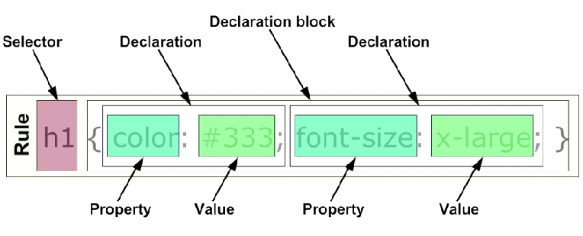
Syntax of CSS

Slide 13
Selector
Selectors are used to declare which part of the markup a style applies to, a kind of match expression.
3 types of selectors
Tag selectors (body, p, div, a)
ID selectors (#wrapper, #sidebar)
Class selectors (.content, .menu)
*The selector is normally the HTML element you want to style
*Selectors should never start with a number, nor should they have spaces in them

Slide 14
ID Selector
The id selector is used to specify a style for a single, unique element.
The id selector uses the id attribute of the HTML element, and is defined with a "#".
The style rule below will be applied to the element with id="wrapper":
#wrapper
{
text-align:center;
border:1px solid red;
Width: 200px;
Height: 100px
}
For example, to identify a paragraph as “head”, use the code:
<div id=“wrapper”>… </div>
*Do NOT start an ID name with a number!

Slide 15
Class Selector
The class selector is used to specify a style for a group of elements. Unlike the id selector, the class selector is most often used on several elements.
This allows you to set a particular style for many HTML elements with the same class.
The class selector uses the HTML class attribute, and is defined with a "."
In the example below, all HTML elements with class="center" will be center-aligned:
.center {text-align:center;}
<h1 class="center">Center-aligned heading</h1>
<p class="center">Center-aligned paragraph.</p>
p.center {text-align:left;}
<p class="left">Center-aligned paragraph.</p>
*Do NOT start an ID name with a number!

Slide 16
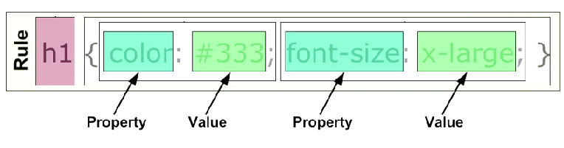
Property & Value
The property is the style attribute you want to change. Each property
has a value
*Properties are separated from their respective values by colons :
*Pairs are separated from each other by semicolons ;

Slide 17
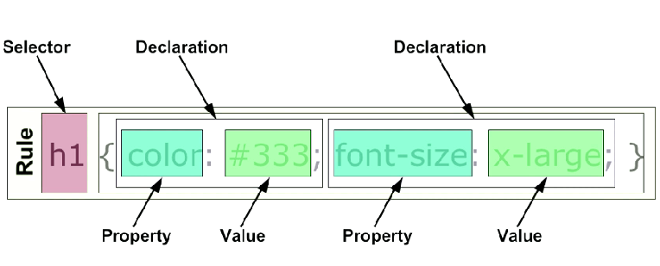
Declaration
Definition: Each CSS line that includes property and value
*Each declaration consists of a property and a value

Slide 18
Declaration Block
A declaration block consists of a list of declarations in braces. Each declaration itself consists of a property and a value. If there are multiple declarations in a block.

Slide 19
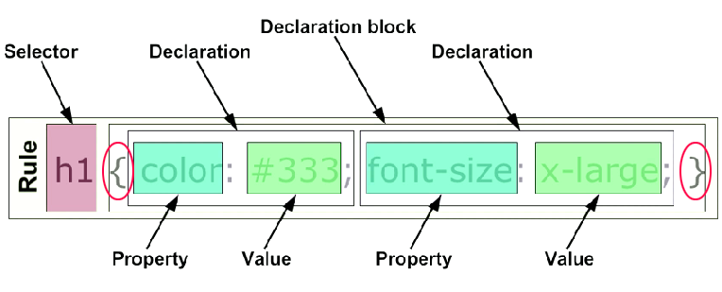
Curly Braces
The curly braces contain the properties of the element you want to manipulate, and the values that you want to change them to. The curly braces plus their content is called a declaration block.

Slide 20
How CSS is Applied to A Web Page
There are three ways of inserting a style sheet:
Inline style
Internal style sheet
External style sheet

Slide 21
Inline style
An inline style loses many of the advantages of style sheets by mixing content with presentation. Use this method sparingly!
To use inline styles you use the style attribute in the relevant tag. The style attribute can contain any CSS property. The example shows how to change the color and the left margin of a paragraph
V <p style=“text-align: center; font-weight: bold; color:yellow;”>
This is a paragraph.
</p>

Slide 22
Internal style sheet
An internal style sheet should be used when a single document has a unique style. You define internal styles in the head section of an HTML page, by using the <style> tag, like this:
<head>
<style type=“text/css”>
hr {color:sienna;}
p {margin-left:20px;}
body{background-image:url("images/back40.gif");}
</style>
</head>

Slide 23
External style sheet
An external style sheet is ideal when the style is applied to many pages. With an external style sheet, you can change the look of an entire Web site by changing one file. Each page must link to the style sheet using the <link> tag. The <link> tag goes inside the head section:
<head>
<linkrel="stylesheet“type="text/css" href="style.css">
<link rel="stylesheet" type="text/css" href="mystyle.css">
</head>
Link to a separate css file

Slide 24
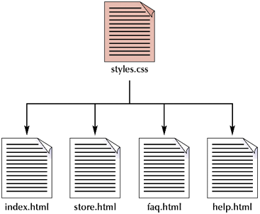
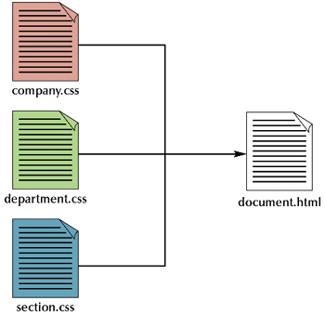
Multiple Style Sheets
You can link a single style sheet to multiple documents in your Web site by using the link element or the @import element
You can also link a single document to several style sheets
@import "container.css";
@import "header.css";
@import "content.css";
@import "footer.css";

Slide 25
Multiple Style Sheets
If some properties have been set for the same selector in different style sheets, the values will be inherited from the more specific style sheet.
For example, an external style sheet has these properties for the h3 selector:
h3{
color:red;
text-align:left;
font-size:8pt;
}

Slide 26
Multiple Style Sheets
And an internal style sheet has these properties for the h3 selector:
h3 {
text-align:right;
font-size:20pt;
}

Slide 27
Multiple Style Sheets
If the page with the internal style sheet also links to the external style sheet the properties for h3 will be:
color:red;
text-align:right;
font-size:20pt;

Slide 28
Cascading order
What style will be used when there is more than one style specified for an HTML element?
Generally speaking we can say that all the styles will "cascade" into a new “virtual" style sheet by the following rules, where number four has the highest priority:
Browser default
External style sheet
Internal style sheet (in the head section)
Inline style (inside an HTML element)
So, an inline style (inside an HTML element) has the highest priority, which means that it will override a style defined inside the <head> tag, or in an external style sheet, or in a browser (a default value).

Slide 29
CSS Box Model
All HTML elements can be considered as boxes. In CSS, the term "box model" is used when talking about design and layout.
The CSS box model is essentially a box that wraps around HTML elements, and it consists of: margins, borders, padding, and the actual content.
The box model allows us to place a border around elements and space elements in relation to other elements.

Slide 30
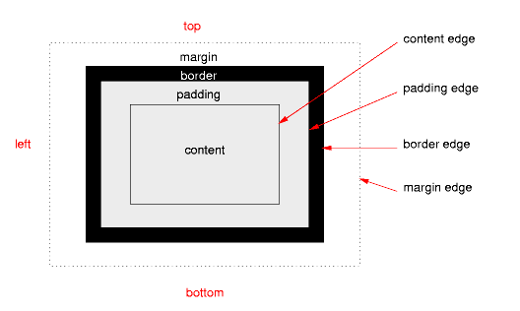
CSS Box Model

Slide 31
Margin, Padding, Border and Content
Explanation of the different parts:
Margin - Clears an area around the border. The margin does not have a background color, it is completely transparent
Border - A border that goes around the padding and content. The border is inherited from the color property of the box
Padding - Clears an area around the content. The padding is affected by the background color of the box
Content - The content of the box, where text and images appear

Slide 32
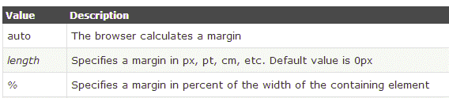
Margin
The CSS margin properties define the space around elements.
The top, right, bottom, and left margin can be changed independently using separate properties. A shorthand margin property can also be used, to change all margins at once.
Possible Values

Slide 33
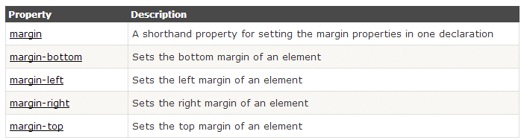
Margin - Individual sides
In CSS, it is possible to specify different margins for different sides:
margin-top:100px;
margin-bottom:100px;
margin-right:50px;
margin-left:50px;
All CSS Margin Properties

Slide 34
Margin - Shorthand property
To shorten the code, it is possible to specify all the margin properties in one property. This is called a shorthand property.
The shorthand property for all the margin properties is "margin":
margin:25px
All Four Side
margin:25px 75px;
Top & bottom - left & right
margin:25px 50px 75px;
Top – right & left - bottom
margin:25px 50px 75px 100px;
Top right bottom & left

Slide 35
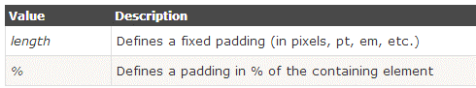
Padding
The padding clears an area around the content (inside the border) of an element. The padding is affected by the background color of the element.
The top, right, bottom, and left padding can be changed independently using separate properties.
Possible Values

Slide 36
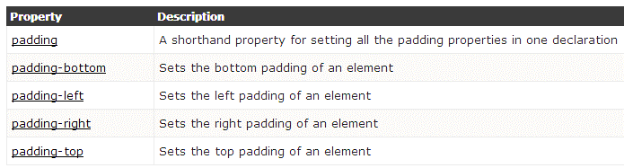
Padding - Individual sides
In CSS, it is possible to specify different margins for different sides:
padding-top:100px;
padding-bottom:100px;
padding-right:50px;
padding-left:50px;
All CSS Padding Properties

Slide 37
Padding - Shorthand property
To shorten the code, it is possible to specify all the padding properties in one property. This is called a shorthand property.
The shorthand property for all the padding properties is "padding":
padding:25px
All Four Side
padding:25px 75px;
Top & bottom - left & right
padding:25px 50px 75px;
Top – right & left - bottom
padding:25px 50px 75px 100px;
Top right bottom & left

Slide 38
Border
The CSS border properties allow you to specify the style and color of an element's border.
Borders fall between the padding and margin and provide an outline around an element. Every border needs three values, a width, style, and color. Shorthand values fall in the order of width, style and color. Longhand, these three values can be broken up into the border-width, border-style, and border-color properties.
Most commonly you will see one sized, solid, single colored borders. Borders do however have the capability to come in numerous sizes, shapes, and colors.

Slide 39
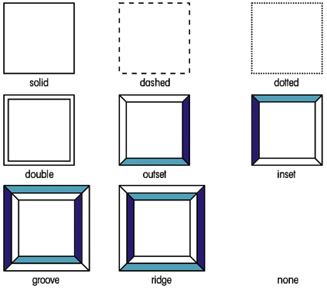
Border Style
The border-style property specifies what kind of border to display.

Slide 40
Border Width
The border-width property is used to set the width of the border.
The width is set in pixels, or by using one of the three pre-defined values: thin, medium, or thick.
The "border-width" property does not work if it is used alone. Use the "border-style" property to set the borders first.

Slide 41


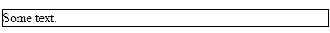
Border Width
.one-box{
border-style:solid;
border-width:5px;
}
.two-box{
border-style:solid;
border-width:medium;
}
.three-box{
border-style:solid;
border-width:1px;
}

Slide 42
Border Color
The border-color property is used to set the color of the border. The color can be set by:
name - specify a color name, like "red"
RGB - specify a RGB value, like "rgb(255,0,0)"
Hex - specify a hex value, like "#ff0000"
You can also set the border color to "transparent".
p.one{
border-style:solid;
border-color:red;
}
p.two{
border-style:solid;
border-color:#98bf21;
}

Slide 43
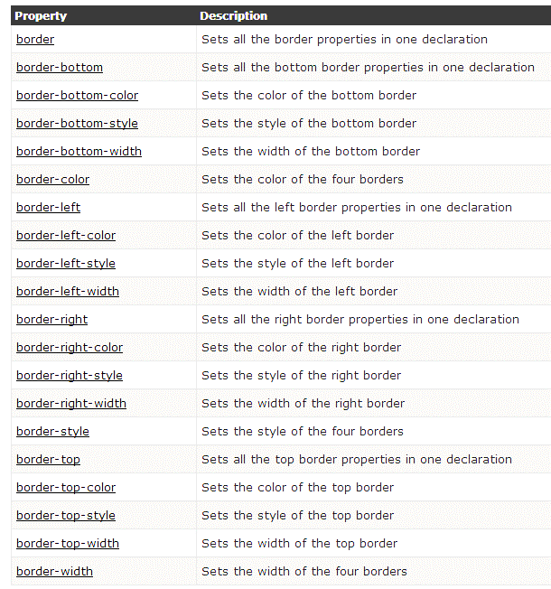
All CSS Border Properties

Slide 44
CSS Box Model
This is commonly called the Box Model. In order to set the width and height of an element correctly in all browsers, you need to know how the box model works.
Here is a way to visualize it...

Slide 45
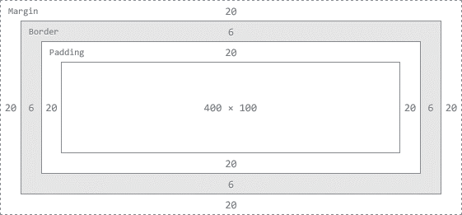
Width and Height of an Element
When you set the width and height properties of an element with CSS, you just set the width and height of the content area. To calculate the full size of an element, you must also add the padding, borders and margins.
The total width of the element in the example below is

Slide 46
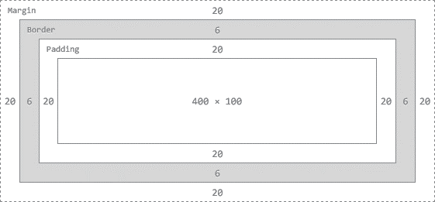
Width and Height of an Element
div {
background: #fff;
border: 6px solid #ccc;
height: 100px;
margin: 20px;
padding: 20px;
width: 400px;
}
To break down the total width of an element, including the box model, use the formula:
margin-right + border-right + padding-right + width + padding-left + border-left + margin-left
In comparison, the total height of an element, including the box model, can be found using the formula:
margin-top + border-top + padding-top + height + padding-bottom + border-bottom + margin-bottom

Slide 47
Width and Height of an Element
div {
background: #fff;
border: 6px solid #ccc;
height: 100px;
margin: 20px;
padding: 20px;
width: 400px;
}
Using the formulas and box context above we can find the total height and width of our example.
Width: 492px = 20px + 6px + 20px + 400px + 20px + 6px + 20px
Height: 192px = 20px + 6px + 20px + 100px + 20px + 6px + 20px

Slide 48
CSS Fundamental
1
2
CSS3 Overview
目录
CONTENTS
3
Responsive Design

Slide 49
CSS3 Overview
Many new properties introduced in CSS3
Number has nearly doubled!
No announcement has yet been made by W3C for a release date
CSS3 is further behind in development compared to HTML5
But browser developers have introduced many CSS3 Properties into their browsers.

Slide 50
CSS3 modules
CSS3 is split up into "modules".
Some of the most important CSS3 modules are
Selectors
Box Model
Backgrounds and Borders
Text Effects
2D/3D Transformations
Animations
Multiple Column Layout
User Interface

Slide 51
CSS3 war
CSS3 is still under active development, and although W3C has defined draft syntax standards, browser developers have started a CSS3 “war” – developing their own syntax for some new CSS3 keywords!
In the not-so-distant past, had to specify a range of
keywords for different browsers in your web page!
E.g.
W3C: border-radius
Safari and Chrome: -webkit-border-radius
Firefox: -moz-border-radius
Internet Explorer: -ms-radius
Opera: -o-radius

Slide 52
CSS3 war
To use, place prefix before CSS property name.
In most cases, only need -moz- and -webkit- prefixes.
Recommended: To future-proof work, include non-prefixed version as last declaration.
Eventually, all browsers will move to W3C standards.
I tried just the W3C keyword for several properties,
and they worked fine.

Slide 53
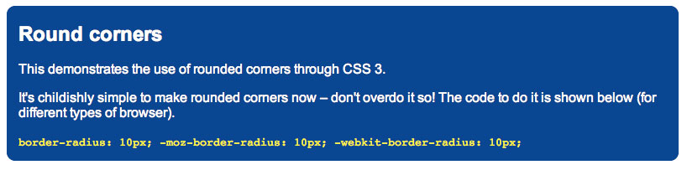
Round Corners
border-radius (or variant depending on browser) is used to make rounded corners
Example: border-radius: 3px
The bigger the value or the radius, the more curvy and larger are the rounded corners
Much simpler than using CSS 2 (no background images etc. needed)

Slide 54
Example
#box { background-color: #74C0FF;
margin-left: 60px;
padding: 5px 10px;
border: 1px solid #000000;
-webkit-border-radius: 15px;
-moz-border-radius: 15px;
border-radius: 15px;
}

Slide 55
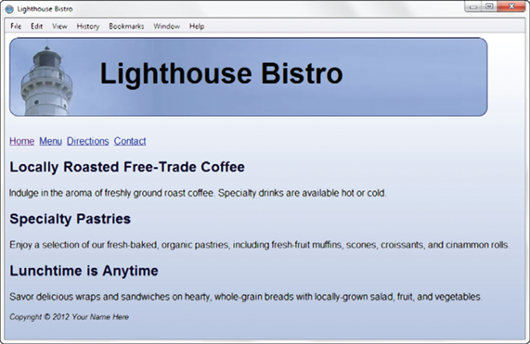
Example(cont.)
h1 { border: 1px solid #000033;
-webkit-border-radius: 15px;
-moz-border-radius: 15px;
border-radius: 15px;
}

Slide 56
Syntax
border-radius: 1-4 lengths;
Note: The four values for each radii are given in the order top-left, top-right, bottom-right, bottom-left.
If bottom-left is omitted it is the same as top-right.
If bottom-right is omitted it is the same as top-left.
If top-right is omitted it is the same as top-left.

Slide 57
Rounded Corners Rendered with Border-Radius Support

Slide 58
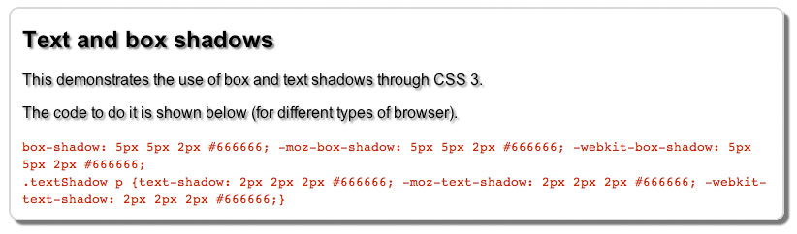
Box- and text-shadow
box-shadow creates a drop shadow effect (3 lengths and a colour)
Example: box-shadow: 10px 6px 5px #888;
10px is horizontal offset, 6px is vertical offset, 5px is ‘blur radius’
To put the shadow on the left and top, use negative values for the first two offsets
Higher blur radius = more blurred
text-shadow is similar but applied to text

Slide 59
Syntax
box-shadow: h-shadow v-shadow blur spread color inset;

Slide 60
Example
#container { margin: auto;
background-color: #ffffff;
width: 800px;
padding: 20px;
-webkit-box-shadow: 5px 5px 5px #1e1e1e;
-moz-box-shadow: 5px 5px 5px #1e1e1e;
box-shadow: 5px 5px 5px #1e1e1e;
}
#wrapper { -webkit-box-shadow: 5px 5px 5px #828282; -moz-box-shadow: 5px 5px 5px #828282; box-shadow: 5px 5px 5px #828282;
}

Slide 61
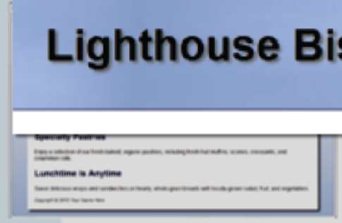
Example
#wrapper {
text-shadow: 3px 3px 3px #666;
}

Slide 62
Opacity
Configure the opacity of the background colour
Opacity range:
0 - Completely Transparent
1 - Completely Opaque
Example:
h1{
background-color: #FFFFFF;
opacity: 0.6;
}

Slide 63
Gradient
Gradient: a smooth blending of shades from one color to another
Use the background-image property
linear-gradient()
radial-gradient()
Example:
background-color: #8FA5CE;
background-image: -webkit-gradient(linear, left top, left bottom, from(#FFFFFF), to(#8FA5CE));
background-image: -moz-linear-gradient(top, #FFFFFF, #8FA5CE);

Slide 64
Gradient Backgrounds
Gradient backgrounds: Creates transitions from one color to another without using images. New in CSS3.
Two primary styles of gradients: linear and radial.
Include fallback option for browsers that do not support background gradient property.
Simple background color or image specified as separate rule prior to background gradient rule in CSS.
To create multicolor gradients: Specify more than two colors and use optional parameter in gradient syntax.

Slide 65
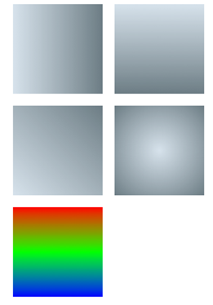
Gradient Backgrounds
Also top, bottom right
.horizontal {
background: #cedce7;
background: linear gradient(left, #cedce7, #596a72);
}
.radial {
background: #cedce7;
background: radial-gradient(center, #cedce7,#596a72);
}

Slide 66
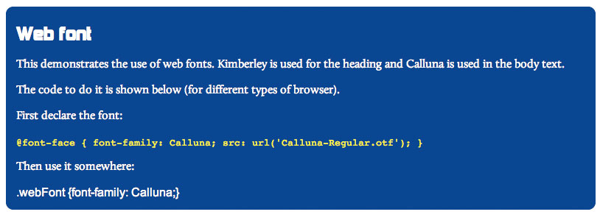
@font-face
@font-face lets you use any licensed TrueType (.ttf) or OpenType (.otf) font on your page
First declare the font: @font-face { font-family: Calluna; src: url('Calluna-Regular.otf');}
Then use it like a normal font: .webFont {font-family: Calluna;}

Slide 67
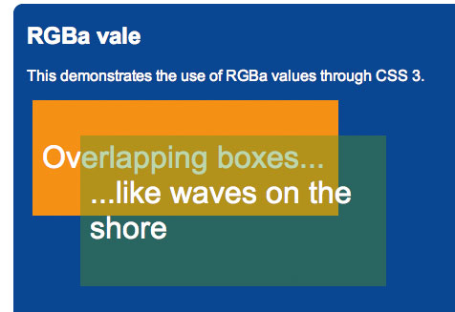
Rgba(alpha channel colour)
rgba lets you specify a normal RGB colour and a value for transparency (alpha channel)
Example: background: rgba(255,0,0.1)
alpha value (last number) is a value between 0 (fully transparent) and 1 (fully opaque)
Big difference with CSS opacity property is that it is not inherited (just applied to background colour and not text)
Ultimately leads to simpler and easier to maintain code and more ‘creative’ possibilities

Slide 68
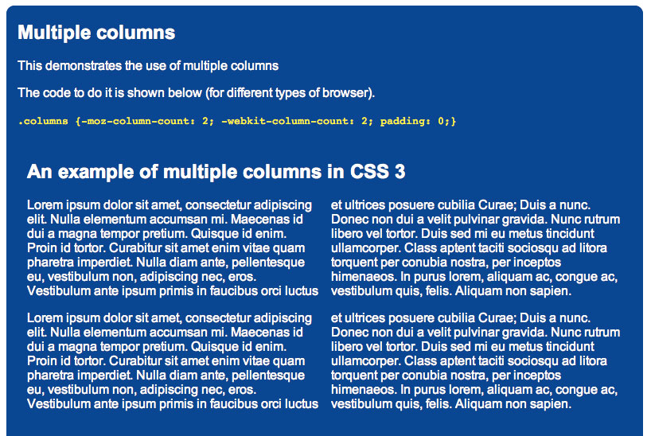
Multi-column layout
Allows you to split text newspaper-like across multiple columns
Express in terms of number of columns or width.
Example 1: column-width: 45%; column-gap 5%;
Example 2: column-count: 3;

Slide 69
CSS Fundamental
1
2
CSS3 Overview
目录
CONTENTS
3
Responsive Design

Slide 70


Borrowed Knowledge

Slide 71
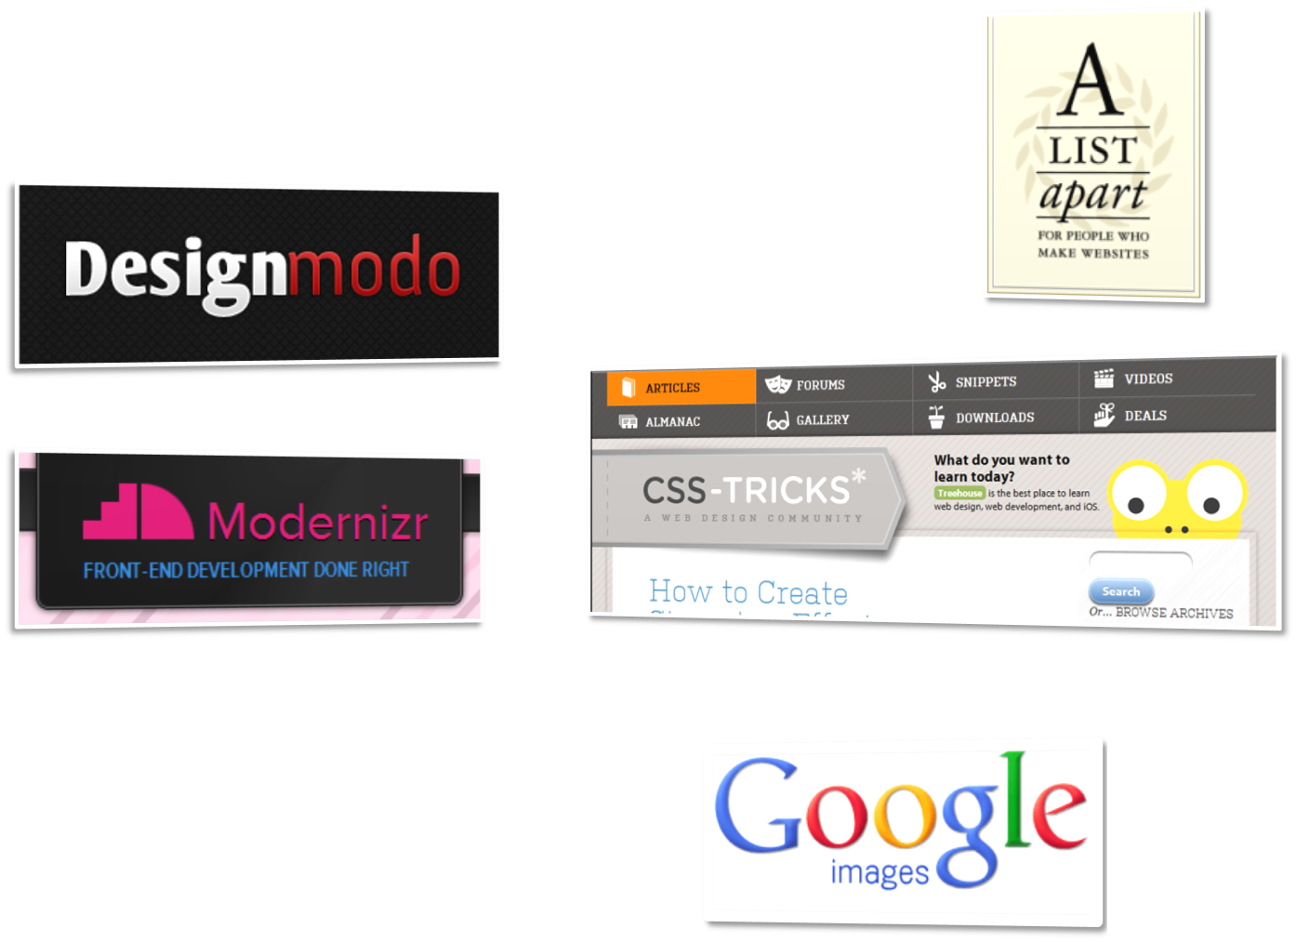
Other “Borrowed” Stuff
Special thanks to all
who contributed to …

Slide 72

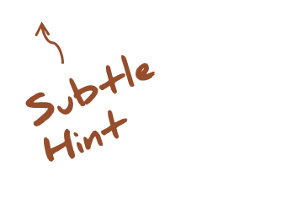
Design Philosophy
What’s the most
frustrating part of
web development?
Notes:
Browser constraints

Slide 73
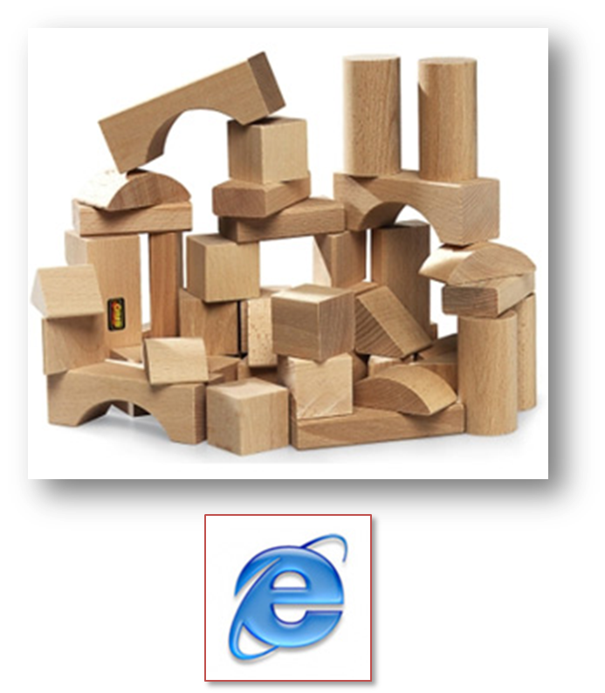
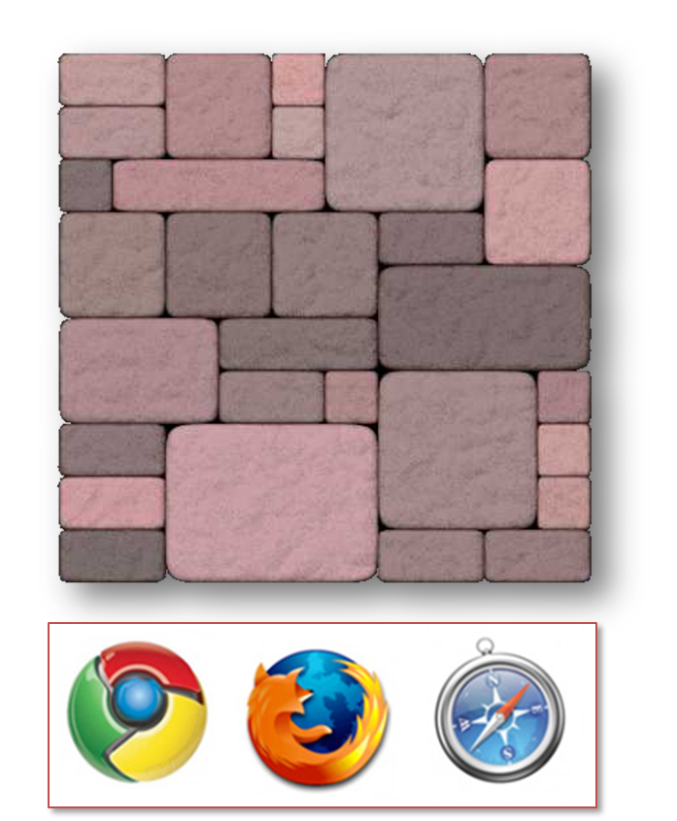
Design Philosophy
Notes:
Print designers took over Show CSS for 960 grid

Slide 74
CSS Browser Hacks
<link href="all.css" rel="stylesheet" type="text/css"/>
<!--[if IE]>
<link href="ie.css" rel="stylesheet" type="text/css"/>
<![endif]-->
<!--[if lt IE 7]>
<link href="ie.below.7.css" rel="stylesheet" type="text/css"/>
<![endif]-->
<!--[if !lt IE 7]>
<link href=“newer.css" rel="stylesheet" type="text/css"/>
<!--<![endif]-->
<!--[if !IE]>-->
<link href="not.ie.css" rel="stylesheet" type="text/css"/>
<!--<![endif]-->
.widget{ display: block; width: 200; float: left; }
* html .widget { zoom: 1;}

Slide 75
Why Bother
People like pretty
“Several studies have conclusively shown that attractive user interfaces are easier to use than [ugly] interfaces”
- Pragmatic Thinking & Learning, Andy Hunt

Slide 76




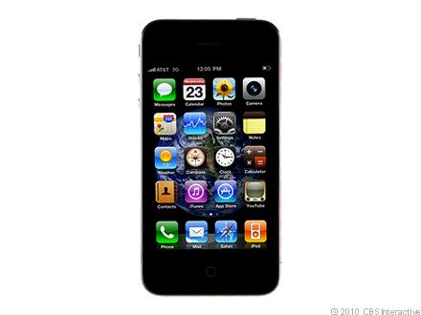




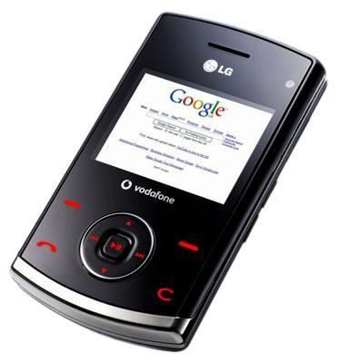


Notes:
CRT monitors, lcd, tablets smart phones, readers, feature phones, Giant screens, and each with the potential of multiple browsers on each

Slide 77
Design Philosophy
A Dao of Web Design
by John Allsopp
APRIL 7, 2000
http://www.alistapart.com/articles/dao/

Slide 78
A Dao of Web Design
“A newborn is soft and tender, A crone, hard and stiff. Plants and animals, in life,
are supple and succulent; In death, withered and dry. So softness and tenderness are attributes of life, And hardness and stiffness, attributes of death.”
Tao Te Ching; 76 Flexibility

Slide 79
A Dao of Web Design
FONTS
“… the same font, at the same point size on a Macintosh ‘looks smaller’ than on most Windows machines … if you embrace the adaptability philosophy it doesn’t matter.”

Slide 80
A Dao of Web Design
LAYOUTS
“As with fixed font sizes, fixed page layout can lead to accessibility problems on the web.”

Slide 81
Moving Forward
IYAD-WYAD-YAG-WYAG*
*If you always do – what you always did
you’ll always get – what you always got

Slide 82
Innovation
IYAD-WYAD-YS*
*If you always do – what you always did
you’re screwed

Slide 83
Responsive Web Design
1. Flexible, grid-based layout
2. Flexible images and media
3. CSS3 Media queries
4. Feature Detection / Polyfills

Slide 84
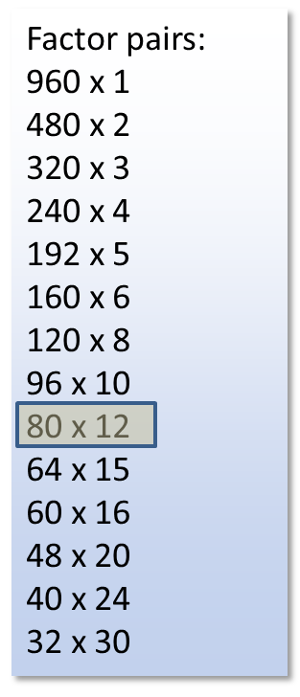

Grid System
Notes:
Print designers took over Show CSS for 960 grid

Slide 85
Responsive Web Design
Flexibility = Relativity

Slide 86

Responsive Web Design

Slide 87
Context for Font size
Context for Font size
100% = 12pt = 16px

Slide 88
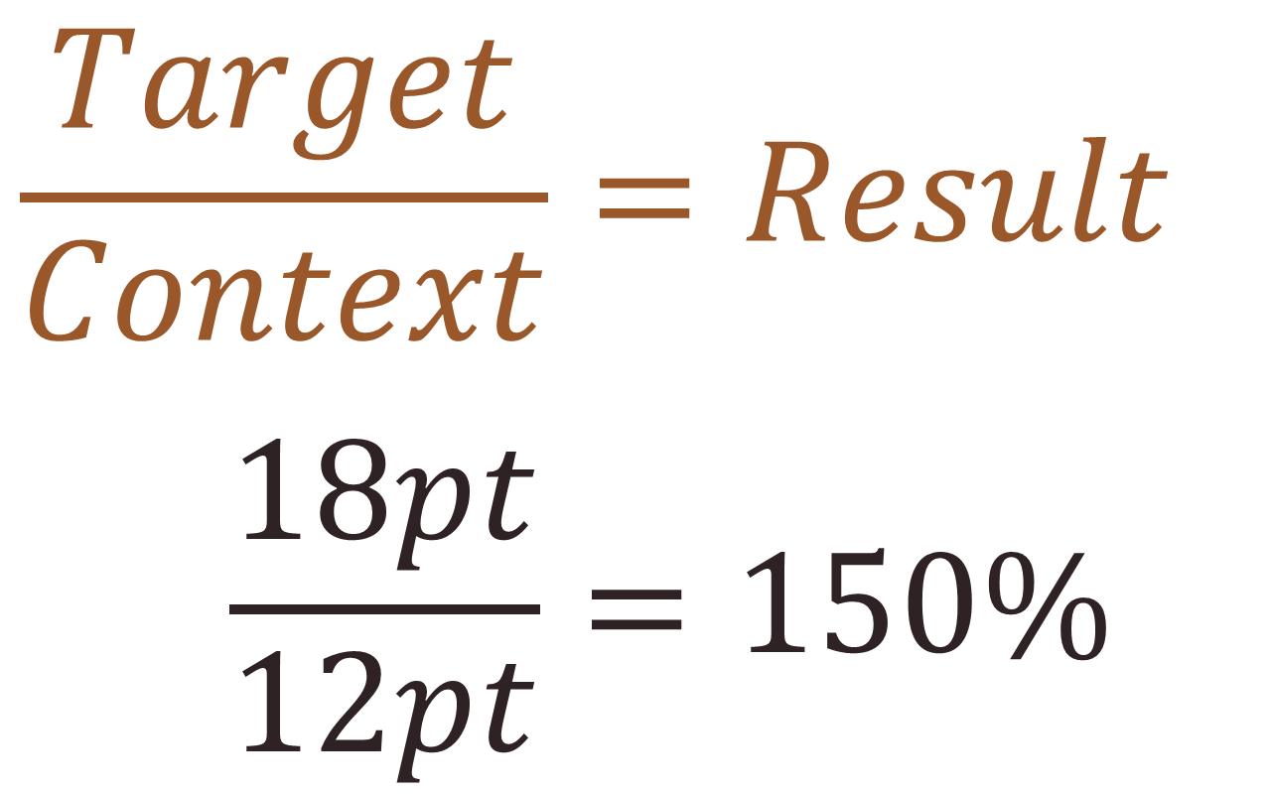
Context for Font size

Slide 89
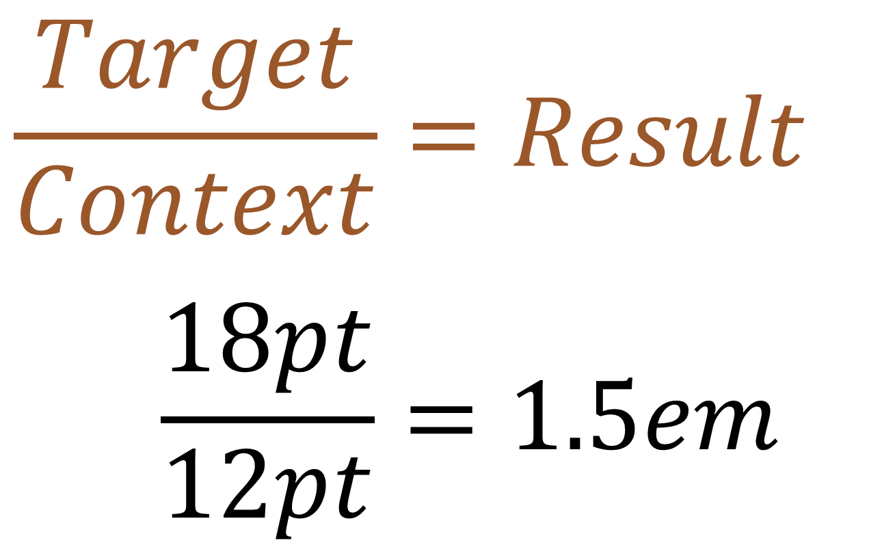
Context for Font size

Slide 90
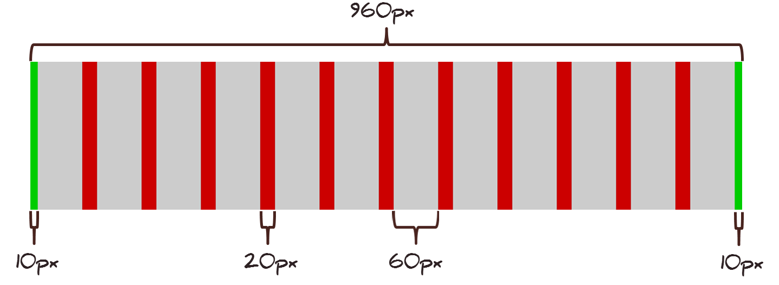
Pizzamore 960px grid
12 Column grid
10px L/R margins
20px gutters
60px columns

Slide 91

Pizzamore Content Inventory
Head Navigation – 5 column
Title Banner – 12 column
Main Title Image – 11 column
Pizza Image – 5 column
Title Text– 7 column
Site Blurb – 10 column
Content Area – 12 column
Article – 9 column
Posts – 5 column
Pizza Roll – 12 column
Pizza Roll Content – 10 column
Links – 10 column
Menu Links – 5 column
Spice Links – 5 column
Footer – 10 column

Slide 92
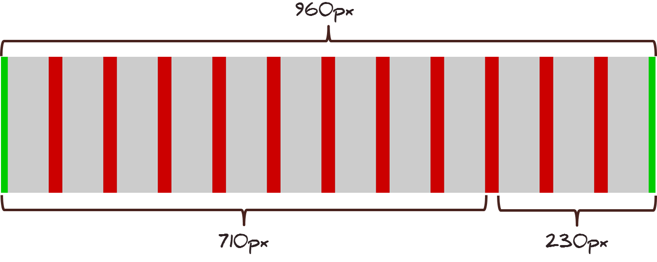
Pizzamore Content Area Layout
Article 9 Columns
710px wide
Posts 3 Columns
230px wide

Slide 93
Flexible Images
img {
max-width: 100%;
height: auto;
}

Slide 94
Flexible Media
img,
embed,
object,
video{
max-width: 100%;
height: auto;
}

Slide 95
Media Queries
Inside style sheet
@media screen and (min-width: 1024px) {
body {
font-size: 120%;
}
}

Slide 96
Media Queries
Media attribute on link element
<link rel="stylesheet“ href=“style/big.css" media="screen and (min-width: 1024px)"/>

Slide 97
Media Queries
Or use import statement
@import url(“big.css")
screen and (min-width: 1024px);

Slide 98
Viewport
Control for canvas size
<meta
name="viewport"
content="initial-scale=1.0, width=device-width"
/>

Slide 99
Polyfill
pol·y·fill /’pälēfil/ n.
“A shim that mimics a future API, providing fallback functionality to older browsers.” – Paul Irish

Slide 100
Feature detection
fea·ture de·tec·tion
/’fēcHər diˈtekshən/ n.
“[A method] to reliably discern what the various browsers can and cannot do.” – modernizr.com

Slide 101
GD vs. PE
Graceful Degradation
vs.
Progressive Enhancement

Slide 102

Mobile First

Slide 103
Responsive Design Tools
Browser Resizing
Resizer (Bookmarklet): codebomber.com/jquery/resizer
Multiple sizes at once (hosted): mattkersley.com/responsive
Responsivepx (test local): responsivepx.com
Text Scaling
FitTextjs - fittextjs.com
Calculators
A Fluid Grid Calculator: csswizardry.com/fluid-grids
px to em calculator - pxtoem.com

Slide 104
Polyfill Tools
Start Here
Modernizr: modernizr.com
Media Queries
Respond.js: github.com/scottjehl/Respond
CSS3 Media Queries.js: code.google.com/p/css3-mediaqueries-js
Display Browser Features
Haz.io: haz.io

Slide 105
Great Reads
Books:
Responsive Web Design: abookapart.com/products/responsive-web-design
Adaptive Web Design: easy-readers.net/books/adaptive-web-design
Mobile First: abookapart.com/products/mobile-first
Blogs:
CSS Tricks: css-tricks.com
A List Apart: alistapart.com
Design Modo: designmodo.com
Articles:
The DAO of Web Design: www.alistapart.com/articles/dao
Redefining web: trentwalton.com/2012/02/02/redefined

Slide 106
THANK
YOU

